Slide 1


Actioning Quotes at CGIC
Group 4
December 3rd, 2021
James Boyle, Shane Sodhi, Naim Boufridi, Maja Leonie Hermann, Janvier Kurawige

Slide 2

Problem Description
Limited Resources to pursue most likely customers
What does our most probable customer look like?
How can we target this segment of our quotes?
Maximization of Broker and Sales team’s time

Slide 3
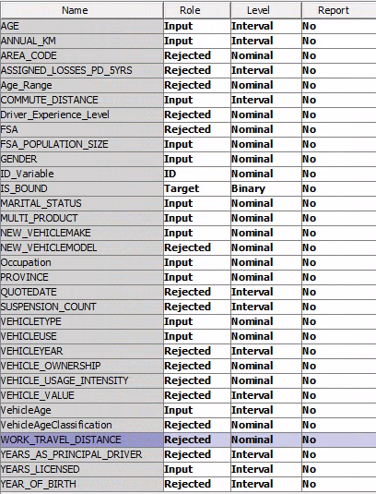
Pre-Processing Steps Taken
Numerical Categories were discretized for the purpose of visualization in our data exploration
Removal of “Dead Quotes” – those with conflicting, redundant, or outlier values were removed entirely
Simplification of categorical variables – For example, converting FSA into Province and FSA Population Size
Discretized categories were removed from predictive models to minimize data skew, and values with high counts of missing values were removed

Slide 4
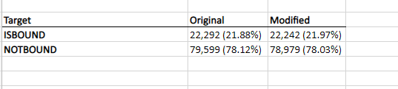
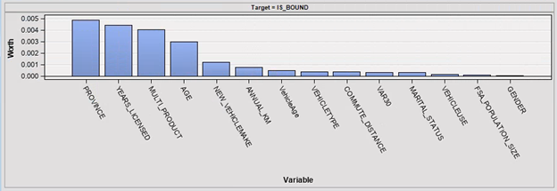
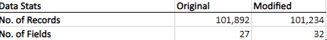
Summary of The Data
The overall provided dataset had a bound rate of %21.97 – This is important to know for benchmarking segment bound rate
Defined our most likely predictors as Geographical Profile, Customer Profile, and Vehicle Profile using attribute ranking

Slide 5
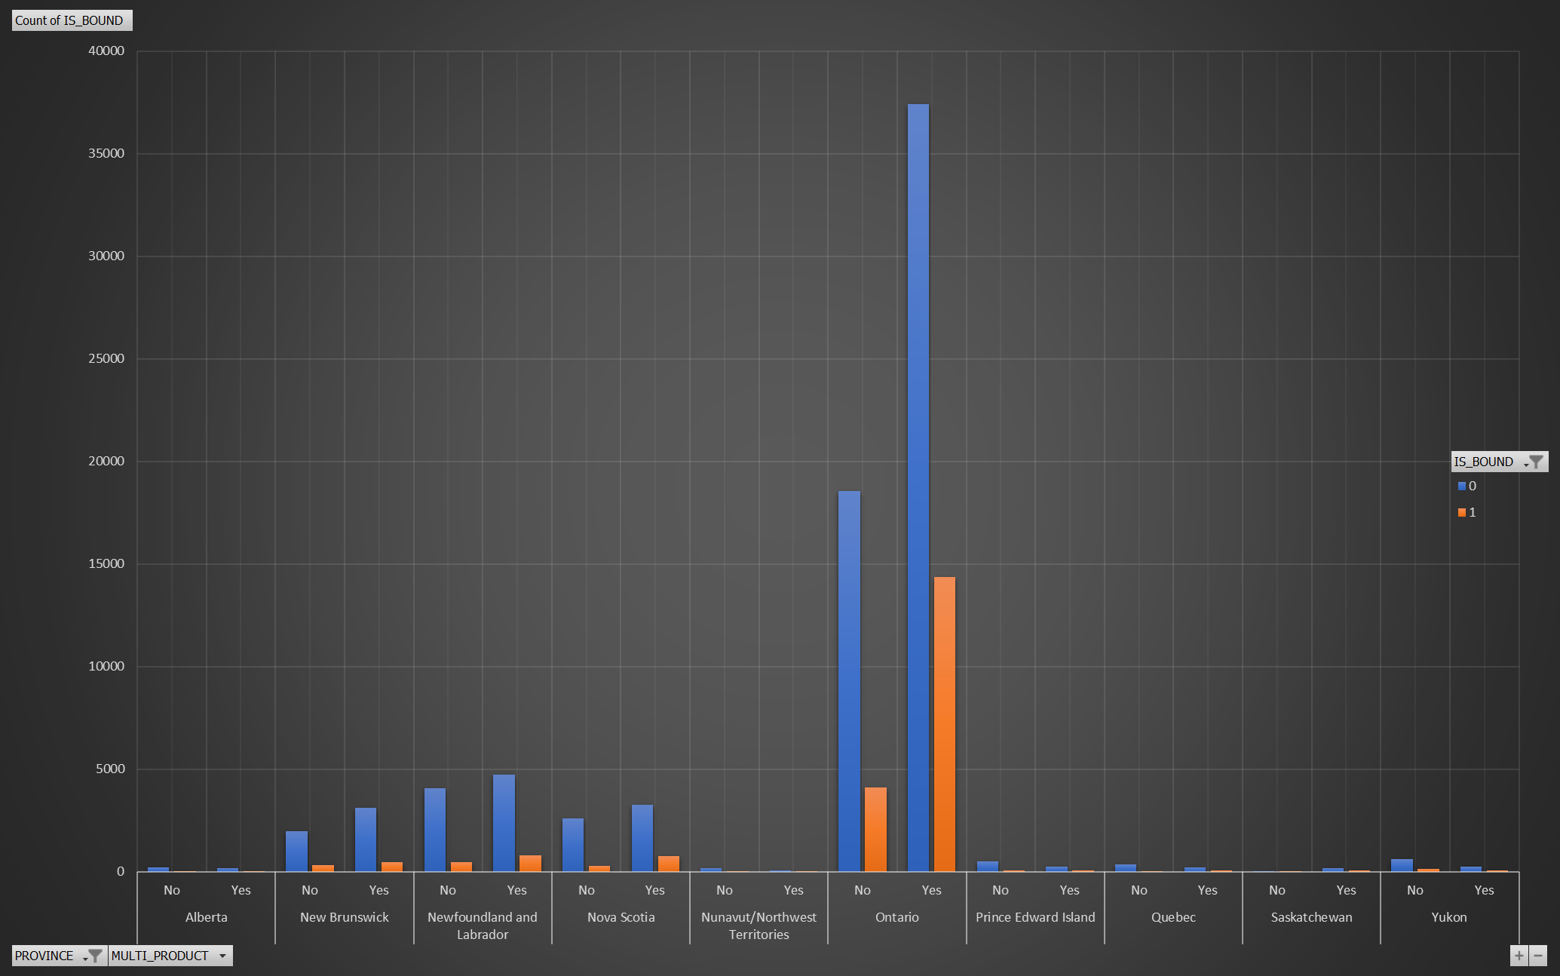
Pivot and Visualization Techniques

Slide 6
Prediction Techniques Used and Key Results
Artificial Neural Network – This was our 2nd best model with a cumulative lift of 1.4089. However, lack of capacity to complete missing values in the vehicle type category hindered the potential of this model.
Regression – This was our least effective model. It delivered a Cumulative lift of 1.35, and an ASE of 0.226
Decision tree produced the best results; Different systematic pre pruning and post pruning measures were used. The model delivered a Cumulative lift of 1.3977 and ROC rate 0.631, and the lowest ASE of 0.225. This model was also the most interpretable

Slide 7
Final Selected Techniques and Model Results
From our decision tree, we discovered a key trend in identifying customer segments
We found that the most ideal customer segment is the quotes where the applicant already has a product with CGIC, lives in Ontario, are younger than 37.5, and have been licensed for over 7.5 years.
This group had the highest bound rate of %37.65! (Adjusted for sampling). This group also accounted for 3,958 total observations (%11 of the overall population)
But what about Vehicle Indicators?

Slide 8
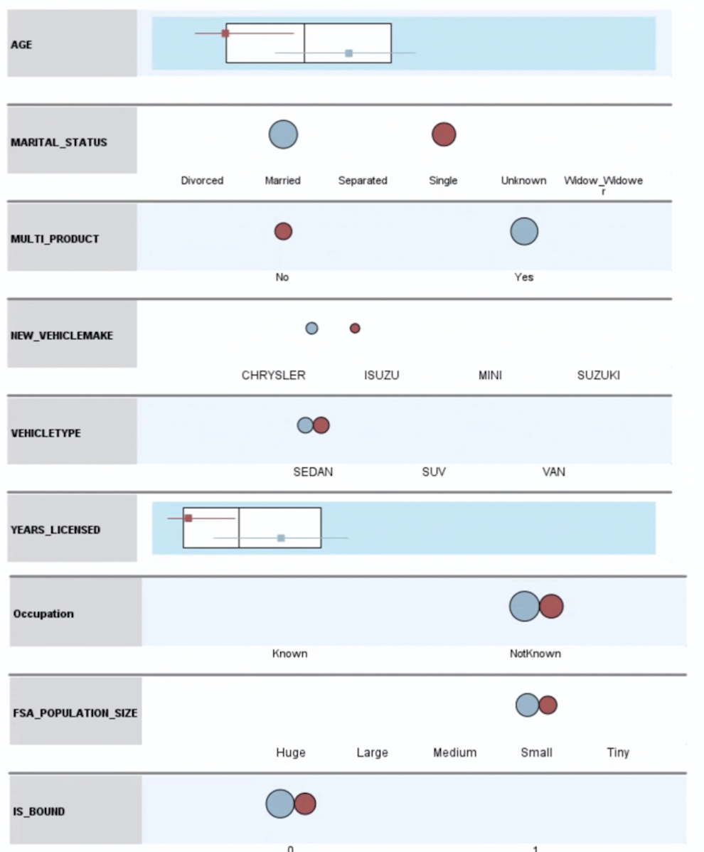
Clustering Results
Identify structures within the data that results in higher bound rate
36.8% of customers: young single adults from a small city that drive a sedan
Driver – Multi Product positive impact on middle aged married person and younger single adults with 3% increase on bound
Vehicle - Ford, SUV and mainly used to commute with annual 14,600km
Location - Ontario and from medium sized population
Notes:
Young adults (27-37) vs Middle aged (43-53) -> mean overall: 42
Multi product positive impact on bound rate when only focusing an attributes regarding the driver Driver focused clustering predicts clusters 22.9 for middle aged and 27.1 bound rate. 70% of our clients fall within one of the 2

Slide 9

Recommendations
Assuming CGIC can only pursue %10 of web quotes from a resource perspective, they should target the %11 we discovered in our decision tree (Multiproduct, Middle-aged, Ontarian, Licensed for over 7.5 years)
Secondary targets should include young single adults from a small city that drive a sedan.
Key target brands include Honda Sedans and Ford SUV’s

Slide 10
Conclusion
What did we learn?
A targeted approach is required for process optimization
We can focus core business objectives on predictive modelling and use it to our advantage
CGIC has an opportunity to maximize the Sales team’s time by focusing their efforts on the sectors found in our analysis

